Slide 1
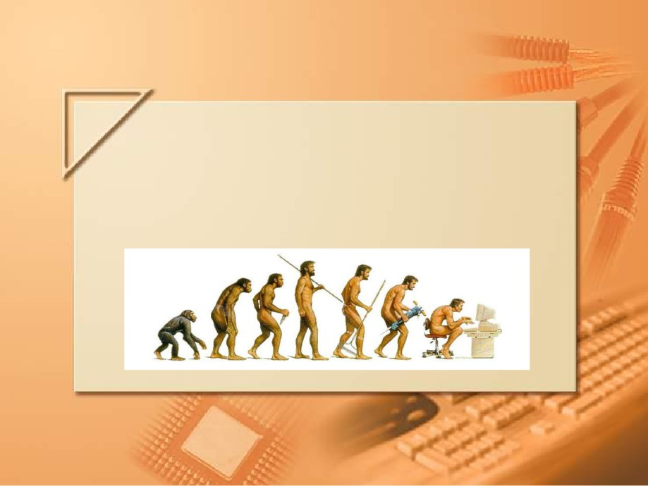
Introduction to Computer Science Course
Workshop, RUNI
Introduction to Computer Science

Slide 2

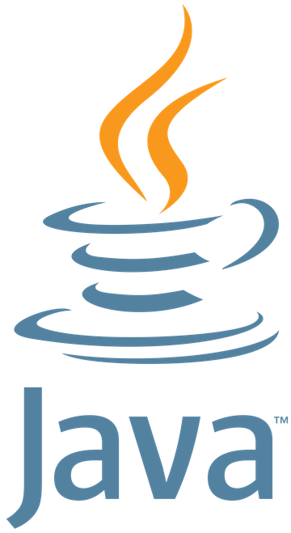

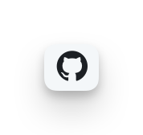
Introduction to the Course Tools
The three key tools:
Java: programming language for application development.
VS Code: an Integrated Development Environment (IDE).
GitHub: version control and collaboration platform (to be covered later).
Notes:
ג'אבה: שפת קוד מרכזית וחשובה שמשתמשים בה לטובת פיתוח
ויזואל סטודיו קוד - פלטפורמה לכתיבת וקמפול קוד
גיט האב - פלטפורמה לשיתוף ושליטה על קוד (יוסבר בהמשך)

Slide 3
Java Configurations
Java comes in two main configurations: The JRE and the JDK.
To run Java programs, you need to install the JRE (Java Runtime Environment) on your PC. This package provides thousands of pre-built libraries that support input/output operations, networking, and user interface management.
To develop Java programs, you need the JDK (Java Development Kit). The JDK includes the JRE, plus a Java compiler and other development tools.
As a CS student at RUNI, you will write many Java programs, so you have to install the JDK on your PC.
Start by downloading to your computer the JDK 23 (the latest JDK version) from the Oracle Java Downloads page.

Slide 4
Java Configurations
Java comes in two main configurations: The JRE and the JDK.
To run Java programs, you need to install the JRE (Java Runtime Environment). This package provides thousands of pre-built libraries that support input/output operations, networking, and user interface management.
To develop Java programs, you need the JDK (Java Development Kit). The JDK includes the JRE, plus a Java compiler and other development tools.
Notes:
JDK - Java Development Kit
סביבת פיתוח שמשתמשים בה לטובת פיתוח אפליקציות בג'אבה.
מכיל את הJRE (Java Runtime Enviroment) ועוד כלי פיתוח.
JRE - Java Runtime Enviroment
היישום של הJVM (המכונה הוירטואלית של ג'אבה) וזו סביבה שניתן להריץ בה תוכניות של ג'אבה (לא לפתח!). כולל גם ספריות של ג'אבה ועוד classes על מנת שהתוכנית תרוץ באופן חלק יותר.
אין בה כלי פיתוח -debugger, compiler וכו'.
אם נרצה להריץ תוכנית, נוכל להוריד רק את הJRE

Slide 5
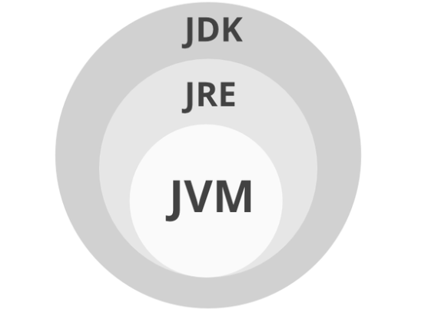
Java Configurations
As a CS student at RUNI, you will write many Java programs, so you have to install the JDK on your PC.
Start by downloading to your computer the JDK 23 (the latest JDK version) from the Oracle Java Downloads page.
Notes:
JDK - Java Development Kit
סביבת פיתוח שמשתמשים בה לטובת פיתוח אפליקציות בג'אבה.
מכיל את הJRE (Java Runtime Enviroment) ועוד כלי פיתוח.
JRE - Java Runtime Enviroment
היישום של הJVM (המכונה הוירטואלית של ג'אבה) וזו סביבה שניתן להריץ בה תוכניות של ג'אבה (לא לפתח!). כולל גם ספריות של ג'אבה ועוד classes על מנת שהתוכנית תרוץ באופן חלק יותר.
אין בה כלי פיתוח -debugger, compiler וכו'.
אם נרצה להריץ תוכנית, נוכל להוריד רק את הJRE

Slide 6
Compilers
Compilers takes our code (generally text files) and prepare a file that we can run from it.
We will use the Java Compiler in order to make our text file an actual Java executable program.
Edit
Compile
Run

Slide 7
Write your first Java program
We’ll go briefly through the steps required to install Java
Note - The course’s site contains a ‘from zero to code’ tutorial with a detailed step–by–step guide on how to get Java working on your computer.
Let’s go through the document step by step.

Slide 8
Writing a simple program
Java is a modern and powerful programming language, but even a simple program involves many technical aspects that we haven't fully explained yet.
Don’t worry about understanding the details now—just follow along.
As the course progresses, these concepts will become clearer.
In Java, a program consists of one or more classes. A class contains zero or more methods (similar to functions in other languages), and each method comprises one or more statements.

Slide 9
Writing a simple program
Example of a Statement:
The following Java statement prints to the screen the text between the double quotes (גרשיים):
Example of a Method:
In Java, program execution always starts with a method named main. Here is an example (be reminded not to worry for now about technical details):
System.out.println ("Hello world!");
public static void main (String[] args) {
System.out.println ("Hello world!");
}

Slide 10
Writing a simple program
Example of a Class:
The main method is "enveloped" in a class structure, as follows:
public class HelloWorld {
public static void main (String[] args) {
System.out.println ("Hello World! My name is [Your Name]");
}
}

Slide 11
Writing a simple program in VS Code
Open VS Code on your computer.
Create a new folder named intro2cs/Workshops/WS1/code/ where you will store your work.
Inside VS Code, open this folder by selecting File > Open Folder... and navigating to intro2cs/WS1/code/.
Create a new file in the folder named HelloWorld.java.
Type the HelloWorld program shown above in previous slide. Replace [Your Name] with your actual name.
Save the file (Ctrl+S or Cmd+S on Mac).
Notes:
● The class name must begin with a capital letter.
● The class name and the file name must match exactly.

Slide 12
Compiling a Java program
Open the integrated terminal in VS Code (Ctrl+` or Cmd+J on Mac)..
In the terminal, make sure you are in the intro2cs/WS1/code/ folder (VS Code should open the terminal in the correct location by default).
If not, navigate there using: cd intro2cs/WS1/code
Compile the program by typing: javac HelloWorld.java

Slide 13

Running a Java program
Execute your program by typing java HelloWorld
If everything is set up correctly, the program will display the following output:
Hello World! My name is [Your Name]

Slide 14


Command Line useful commands
Command | cmd | terminal
Navigate Directory | cd | cd
List Directory | dir | ls
Clear | cls | clear
Auto Complete | tab | tab
Previous Command | ↑ | ↑
Parent Directory | .. | ..
And Many More… | Go Explore | Go Explore

